Slide 1
Lecture 13: Swapping + RAID
CS343 – Operating Systems
Branden Ghena – Fall 2024
Some slides borrowed from: Stephen Tarzia (Northwestern), Shivaram Venkataraman (Wisconsin), and UC Berkeley CS162

Slide 2
Administrivia
Driver Lab due Thursday!
Be sure to write your own test code that checks various edge cases
There are lots of little edge cases in graphics
We’re grading tests on the metric “did they try at all”
Be willing to use your slip days if you need
You can also use them on Paging Lab

Slide 3
Today’s Goals
Introduce swapping as a mechanism for enabling more virtual memory than physical memory.
Understand several page replacement policies that control swapping.
Explore topic of RAID – redundancy in disks.

Slide 4
Virtual Memory
(Process B Only!)
Process A
Physical Memory (RAM)
Shared
Process B
0
1
2
3
4
5
6
7
8
Process A
0
1
2
3
4
5
6
Process B
Process A
Process B Page Table
Process B
VPN | PPN | Valid?
0 | 2 | 1
1 | X | 0
2 | X | 0
3 | 6 | 1
4 | X | 0
5 | X | 0
6 | X | 0
7 | 4 | 1
8 | X | 0
Process B
CPU
Process A
Process B
Process A
Process B
Process B

Slide 5
The OS view on memory
Managed through virtual memory translation
Paging (or Segmentation) that we talked about last time
OS chooses which portions of processes go in RAM
Lazy loading: don’t put stuff in RAM until it’s needed
If memory overfills, some portions of memory get “swapped” to disk
Writeable memory (stack, heap, global data) must be preserved
Read-only memory (code) can be reloaded from original location

Slide 6
Outline
Swapping
Overview
When To Swap
Page Replacement Policies
Implementing LRU
RAID

Slide 7
Virtual Memory
(Process B Only!)
Physical Memory (RAM)
Shared
Process B
0
1
2
3
4
5
6
7
8
Process A
Process B
0
1
2
3
4
5
6
Process B
Process B
Process B
Process B
Process B
Process B
DISK
CPU
Process B
Process B
Process B
Process B
Process B
Process B
Process B

Slide 8
Motivation for swapping
Processes should be independent of the amount of physical memory
Should be correct, even if not performant
OS goal: support processes when not enough physical memory
Multiple processes combining to more than physical memory
Single process with very large address space
Video games: Astro Bot – 66 GB
Large-scale data processing: Compiling Android – 64 GB
Google uses 72-core machines with 64 GB of RAM for a 40-minute build
OS provides illusion of more physical memory by using disk

Slide 9
Locality of reference
If disk is involved with memory, won’t this be ridiculously slow?
Leverage locality of reference within process
Spatial: memory addresses near referenced address likely to be next
Temporal: referenced addresses likely to be referenced again
Processes spend majority of time in a small portion of code
Estimate: 90% of time spent in 10% of code (loops)
Implication
Process only uses small amount of address space at any moment
Only small amount of address space needs to be in physical memory
RAM acts as a sort of cache for program memory

Slide 10
How swapping works
OS moves some pages from RAM to disk
Processes can still run when not all pages are in physical memory
OS and hardware cooperate to make memory available when needed
Same behavior as if all of address space always was in memory
Except in terms of time, but processes don’t know about time…
Requirements
OS needs mechanism to identify location of address space pages on disk and move them into RAM when necessary
OS needs policy to determine which pages go in RAM or disk

Slide 11
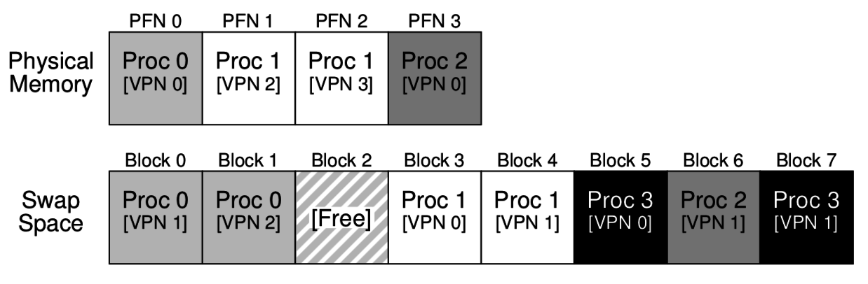
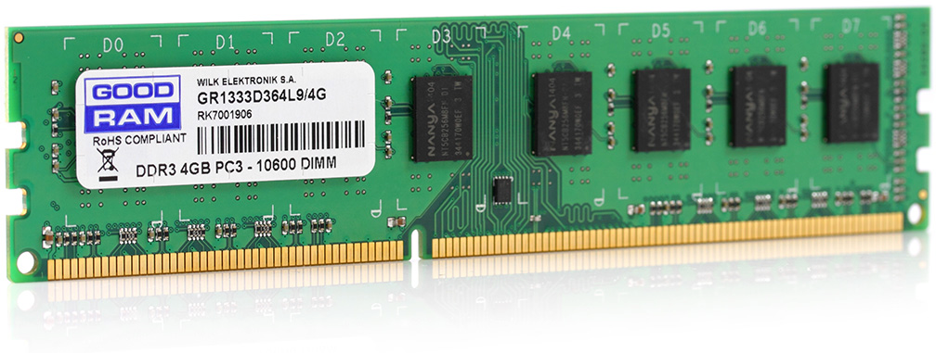
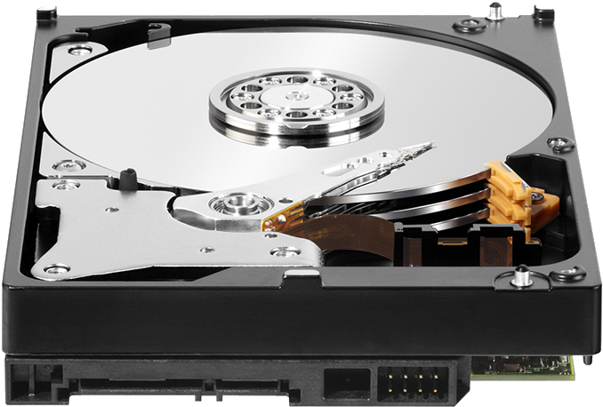
Combination of swapping and paging
Processes have memory pages, which are distributed among RAM and Disk
Example:
Processes 0, 1, and 2 are partially in RAM
Process 3 is entirely in “swap space” on disk

Slide 12
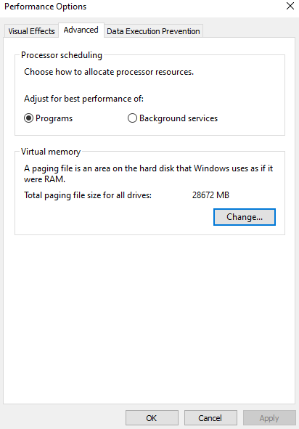
Paging on Windows
Windows lets you see and even set the size of swap space on disk
This is only space for temporary storage of physical memory pages (from RAM)
After it runs out, other processes can’t be loaded!
This is separate from leaving some parts of a process on disk on unloaded

Slide 13
Mechanisms to support swapping
Each page in virtual address space lives in a location
Physical memory
Disk
Nowhere
Use one of the bits in each page table entry to track this – Present bit
Page table entry contains: Physical Page Number, Permissions, Present, Metadata
Page in memory: Present
Page on disk: Not Present
Trap to OS on attempted access
Page Table Entry points to block on disk instead!
Maybe never loaded before, or maybe moved to swap space (works the same either way)
Invalid page: Not Present (and invalid block number)
Trap to OS on attempted access

Slide 14
Types of page faults
Minor/soft: Page is loaded in memory, but PTE is not configured:
Memory could be a shared library already in memory from another process.
OS could be tracking accesses to this page. (hardware without a dirty bit)
Response: update the PTE.
Major/hard: A disk access will be needed:
Anonymous page (process data) may have been swapped out.
Lazy-loading program executable. (this is the more common reason)
Response: load the page from disk
Invalid: User program misbehaved:
Dereference null or invalid pointer.
Write to page that is read-only.
Execute code on a page that is not executable (for security).
Response: terminate the process.

Slide 15
Short Break + Question
Which types of pages do we need to save on disk if they can’t fit in RAM?
File-backed (loaded from a file initially) or Anonymous (all zeros initially)
File-backed, unmodified?
File-backed, modified?
Anonymous, unmodified?
Anonymous, modified?

Slide 16
Short Break + Question
Which types of pages do we need to save on disk if they can’t fit in RAM?
File-backed (loaded from a file initially) or Anonymous (all zeros initially)
File-backed, unmodified?
No need to save, can just read again from file on disk
File-backed, modified?
Must save
Anonymous, unmodified?
No need to save, all zeros anyways
Anonymous, modified?
Must save
Modified pages always need to be saved!

Slide 17
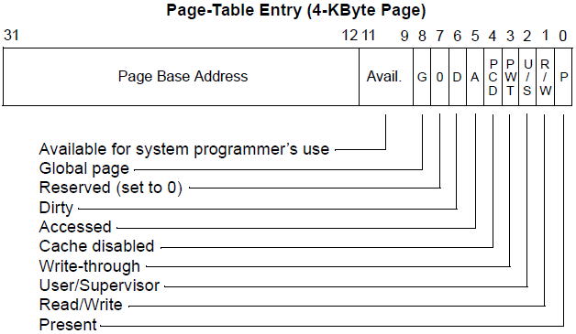
Other bits in a page table entry
Page Base Address can be reused to hold disk block
Dirty bit
Whether page has been modified
If page needs to be swapped out, only preserve if modified
64-bit version is mostly a bigger Page Base Address
Plus some reserved bits
And most-significant bit is “Execute Disable”

Slide 18
Steps to a memory access with swapping
Hardware checks TLB for virtual address
If Hit, address translation complete AND page in physical memory
Hardware (or OS) walks page tables
If valid and present, then page in physical memory
Trap into OS (a.k.a. Page Fault!)
If invalid or bad permissions, fault process (segmentation fault)
If valid but not present
If memory is full, select a victim page in memory to replace
If modified (dirty), write to disk
Invalidate TLB entry for that page
OS reads referenced page from disk into memory
Page table is updated, present bit is set
Resume process execution
New!

Slide 19
Outline
Swapping
Overview
When To Swap
Page Replacement Policies
Implementing LRU
RAID

Slide 20
Policies to determine swapping evictions
Goal: minimize the number of hard page faults
Hard page faults need to read/write from disk and are very slow
So the OS can take plenty of time to make a good decision
OS has two decisions
Page Selection
When should a page be brought into memory?
Page Replacement
When should a page be swapped into disk?
Which page should be swapped out of physical memory?

Slide 21
When do we load in pages? (page selection)
Demand paging: Load page only when page fault occurs (lazy)
Intuition: Wait until page must absolutely be in memory
When process starts: No pages are loaded in memory
Problems: Pay cost of page fault for every newly accessed page
Pre-paging (prefetching): Load page before referenced (eager)
OS predicts future accesses and brings pages into memory early
Works well for some access patterns (e.g., sequential)
Hints: Combine above with user-supplied hints about page references
User specifies: “may need page in future”, “don’t need this page for a while”, or “sequential access pattern”, ...
Example: madvise() in POSIX – gives the OS advice about use of memory

Slide 22
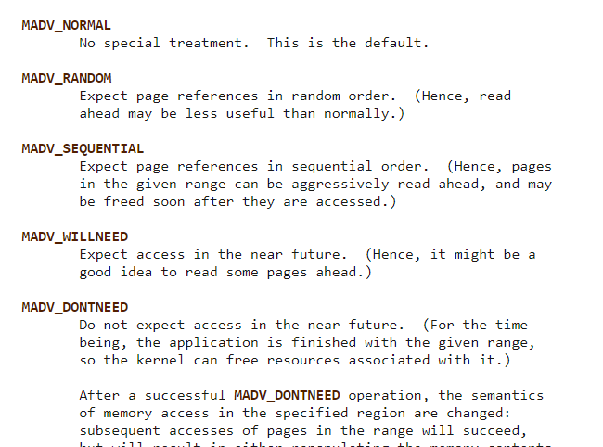
madvise() hints
https://man7.org/linux/man-pages/man2/madvise.2.html

Slide 23
When do we swap out pages? (page replacement)
Demand swapping: whenever the page fault actually occurs
Simplest method
Swap actually occurs asynchronously
Start the disk I/O and block the process that faulted
Background swapping: preemptively when RAM is getting full
Background service in kernel periodically runs (kswapd)
If number of free physical pages < “low water mark”, evict a bunch
Writing many pages to disk in one operation is way more efficient

Slide 24
Thrashing
Thrashing: when swapping happens frequently
Policy could be bad (working set keeps getting swapped to disk)
More likely RAM is too small
Frequent swapping slows down the whole computer to a crawl
Constantly waiting on disk I/O!
Solution for thrashing
Kill processes until it stops (relieves memory pressure)
Install more RAM in the computer

Slide 25
Outline
Swapping
Overview
When To Swap
Page Replacement Policies
Implementing LRU
RAID

Slide 26
Which page should be evicted?
Page replacement policy determines which page to evict
Very similar process as cache eviction or TLB eviction
Misses are expensive, so make sure you evict the right page
Difference: hard page faults are extremely long and handled in software
So a sophisticated policy is possible

Slide 27
Optimal page replacement policy
Optimal page replacement
Evict page that will be accessed furthest in the future
Advantages
Guaranteed to minimize the number of page faults
Disadvantages
Requires the OS to predict the future 🧙
Doesn’t actually exist
This is a performance “upper bound”
This is the best anything can do, so it is useful to compare against
Easy enough to calculate after memory accesses have finished
Still has misses due to cold-start and capacity

Slide 28
First-In-First-Out replacement policy
FIFO replacement
Evict page that has been in memory the longest
Advantages
Fair as all pages have equal residency
Easy to implement
Disadvantages
Some pages of memory are always needed (stack)
Memory doesn’t really need “fairness” like processes did

Slide 29
Least Recently Used replacement policy
LRU replacement
Replace page not accessed for longest time
Using the past to predict the future (temporal locality)
Advantages
With locality, LRU approximates Optimal
Disadvantages
Harder to implement as we need to track when pages are accessed
Cyclical patterns can make LRU fail (bigger concern for cache than RAM)

Slide 30
Practice – simple replacement policies
Page Requested
Optimal
FIFO
LRU
D
D
B
B
A
C
B
D
B
D
D
D
B
B
A
C
B
D
B
D
D
D
B
B
A
C
B
D
B
D
time

Slide 31
Practice – simple replacement policies
Page Requested
Optimal
FIFO
LRU
D
D
Miss
D
D
B
B
A
C
B
D
B
D
D
D
B
B
A
C
B
D
B
D
D
D
Hit
B
D
B
Miss
B
D
B
Hit
A
D
B
A
Miss
C
time
B
D
B
D

Slide 32
Practice – simple replacement policies
Page Requested
Optimal
FIFO
LRU
D | D |  |  | Miss
D | D |  |  | Hit
B | D | B |  | Miss
B | D | B |  | Hit
A | D | B | A | Miss
C
B
D
B
D
D | D |  |  | Miss
D | D |  |  | Hit
B | D | B |  | Miss
B | D | B |  | Hit
A | D | B | A | Miss
C
B
D
B
D
D | D |  |  | Miss
D | D |  |  | Hit
B | D | B |  | Miss
B | D | B |  | Hit
A | D | B | A | Miss
C
B
D
B
D
time
These are only replacement policies. So they don’t matter until RAM is full!

Slide 33
Practice – simple replacement policies
Page Requested
Optimal
FIFO
LRU
D
D
Miss
D | D |  |  | Miss
D | D |  |  | Hit
B | D | B |  | Miss
B | D | B |  | Hit
A | D | B | A | Miss
C
B
D
B
D
D | D |  |  | Miss
D | D |  |  | Hit
B | D | B |  | Miss
B | D | B |  | Hit
A | D | B | A | Miss
C
B
D
B
D
D
D
Hit
B
D
B
Miss
B
D
B
Hit
A
D
B
A
Miss
C
D
B
C
Miss
time
B
D
B
C
Hit
D
D
B
C
Hit
B
D
B
C
Hit
D
D
B
C
Hit
For Optimal, which page do we replace?

Slide 34
Practice – simple replacement policies
Page Requested
Optimal
FIFO
LRU
D | D |  |  | Miss
D | D |  |  | Hit
B | D | B |  | Miss
B | D | B |  | Hit
A | D | B | A | Miss
C | D | B | C | Miss
B | D | B | C | Hit
D | D | B | C | Hit
B | D | B | C | Hit
D | D | B | C | Hit
D
D
Miss
D | D |  |  | Miss
D | D |  |  | Hit
B | D | B |  | Miss
B | D | B |  | Hit
A | D | B | A | Miss
C
B
D
B
D
D
D
Hit
B
D
B
Miss
B
D
B
Hit
A
D
B
A
Miss
C
C
B
A
Miss
time
B
C
B
A
Hit
D
C
D
A
Miss
B
C
D
B
Miss
D
C
D
B
Hit
For FIFO, which pages do we replace?

Slide 35
Practice – simple replacement policies
Page Requested
Optimal
FIFO
LRU
D | D |  |  | Miss
D | D |  |  | Hit
B | D | B |  | Miss
B | D | B |  | Hit
A | D | B | A | Miss
C | D | B | C | Miss
B | D | B | C | Hit
D | D | B | C | Hit
B | D | B | C | Hit
D | D | B | C | Hit
D | D |  |  | Miss
D | D |  |  | Hit
B | D | B |  | Miss
B | D | B |  | Hit
A | D | B | A | Miss
C | C | B | A | Miss
B | C | B | A | Hit
D | C | D | A | Miss
B | C | D | B | Miss
D | C | D | B | Hit
D
D
Miss
D
D
Hit
B
D
B
Miss
B
D
B
Hit
A
D
B
A
Miss
C
C
B
A
Miss
time
B
C
B
A
Hit
D
C
B
D
Miss
B
C
B
D
Hit
D
C
B
D
Hit
For LRU, which pages do we replace?

Slide 36
Practice – simple replacement policies
Page Requested
Miss rate = 40%
Miss rate = 60%
Miss rate = 50%
Optimal
FIFO
LRU
D | D |  |  | Miss
D | D |  |  | Hit
B | D | B |  | Miss
B | D | B |  | Hit
A | D | B | A | Miss
C | D | B | C | Miss
B | D | B | C | Hit
D | D | B | C | Hit
B | D | B | C | Hit
D | D | B | C | Hit
D | D |  |  | Miss
D | D |  |  | Hit
B | D | B |  | Miss
B | D | B |  | Hit
A | D | B | A | Miss
C | C | B | A | Miss
B | C | B | A | Hit
D | C | D | A | Miss
B | C | D | B | Miss
D | C | D | B | Hit
D | D |  |  | Miss
D | D |  |  | Hit
B | D | B |  | Miss
B | D | B |  | Hit
A | D | B | A | Miss
C | C | B | A | Miss
B | C | B | A | Hit
D | C | B | D | Miss
B | C | B | D | Hit
D | C | B | D | Hit
time
For each, what are the final miss rates?

Slide 37
Break + Open Question
Come up with a scenario where LRU does worse than FIFO
D | D |  |  | Miss
D | D |  |  | Hit
B | D | B |  | Miss
D | D | B |  | Hit
A | D | B | A | Miss
?
?
?
?

Slide 38
Break + Open Question
Come up with a scenario where LRU does worse than FIFO
D | D |  |  | Miss
D | D |  |  | Hit
B | D | B |  | Miss
D | D | B |  | Hit
A | D | B | A | Miss
C |  |  |  | Miss
?
?
?
Needs to start with a miss to evict something

Slide 39
Break + Open Question
Come up with a scenario where LRU does worse than FIFO
D | D |  |  | Miss
D | D |  |  | Hit
B | D | B |  | Miss
D | D | B |  | Hit
A | D | B | A | Miss
C |  |  |  | Miss
B
D
A
Repeat prior access pattern
LRU assumes you won’t use the least recent data. So patterns that always use the least recent data are BAD!

Slide 40
Break + Open Question
Come up with a scenario where LRU does worse than FIFO
FIFO
LRU
D | D |  |  | Miss
D | D |  |  | Hit
B | D | B |  | Miss
D | D | B |  | Hit
A | D | B | A | Miss
C | C | B | A | Miss
B | C | B | A | Hit
D | C | D | A | Miss
A | C | D | A | Hit
D | D |  |  | Miss
D | D |  |  | Hit
B | D | B |  | Miss
D | D | B |  | Hit
A | D | B | A | Miss
C | D | C | A | Miss
B | B | C | A | Miss
D | B | C | D | Miss
A | B | A | D | Miss

Slide 41
Outline
Swapping
Overview
When To Swap
Page Replacement Policies
Implementing LRU
RAID

Slide 42
Implementing LRU
Implementing perfect LRU is difficult in practice
Software perfect LRU
OS maintains an ordered list of physical pages by reference time
When page is referenced: move to end of list
When swap is needed: evict front of list
Tradeoff: slow on memory reference, fast on replacement (unacceptable)
Hardware perfect LRU
Associate a timestamp with each physical page
When page is referenced: hardware updates timestamp for page
When swap is needed: OS searches through all pages for oldest
Tradeoff: fast on memory reference, extremely slow on replacement and needs special hardware

Slide 43
Clock algorithm
LRU approximates Optimal anyways, so approximate a little more
Goal: find an old page, not necessarily the oldest page
Real memory has many pages, so there are likely many similarly old pages
Clock algorithm
One “accessed” bit added to each page
When page is referenced: accessed bit is set to one (hardware)
When swap is needed:
Cycle through pages looking for one with accessed bit zero
Update accessed bit to zero after checking a page
Continue from where you left off when next swap is needed
Essentially looks for page that hasn’t been referenced this “cycle”

Slide 44
Clock algorithm example
(Page Name, Accessed Bit)
Initial setup
6 pages total fit in memory
Accessed starts as zero
“clock hand” points at first page
A, 0
B, 0
C, 0
D, 0
E, 0
F, 0

Slide 45
Clock algorithm example
(Page Name, Accessed Bit)
After running a little while
Pages A, B, E are accessed
A, 1
B, 1
C, 0
D, 0
E, 1
F, 0

Slide 46
Clock algorithm example
(Page Name, Accessed Bit)
OS needs to swap pages
Algorithm starts
A is recently accessed
A, 1
B, 1
C, 0
D, 0
E, 1
F, 0

Slide 47
Clock algorithm example
(Page Name, Accessed Bit)
OS needs to swap pages
Algorithm starts
A is recently accessed
B is recently accessed
A, 0
B, 1
C, 0
D, 0
E, 1
F, 0

Slide 48
Clock algorithm example
(Page Name, Accessed Bit)
OS needs to swap pages
Algorithm starts
A is recently accessed
B is recently accessed
C has not been recently accessed
A, 0
B, 0
C, 0
D, 0
E, 1
F, 0

Slide 49
Clock algorithm example
(Page Name, Accessed Bit)
OS needs to swap pages
Algorithm starts
A is recently accessed
B is recently accessed
C has not been recently accessed
So swap it
And advance hand once more
A, 0
B, 0
G, 0
D, 0
E, 1
F, 0

Slide 50
Clock algorithm example
(Page Name, Accessed Bit)
Programs continue running for a while
Pages G, D, F are accessed
A, 0
B, 0
G, 1
D, 1
E, 1
F, 1

Slide 51
Clock algorithm example
(Page Name, Accessed Bit)
OS needs to swap again
Algorithm begins again
But with hand starting somewhere new
A, 0
B, 0
G, 1
D, 1
E, 1
F, 1

Slide 52
Clock algorithm example
(Page Name, Accessed Bit)
OS needs to swap again
Algorithm begins again
But with hand starting somewhere new
D recently accessed
A, 0
B, 0
G, 1
D, 0
E, 1
F, 1

Slide 53
Clock algorithm example
(Page Name, Accessed Bit)
OS needs to swap again
Algorithm begins again
But with hand starting somewhere new
D recently accessed
E recently accessed
A, 0
B, 0
G, 1
D, 0
E, 0
F, 1

Slide 54
Clock algorithm example
(Page Name, Accessed Bit)
OS needs to swap again
Algorithm begins again
But with hand starting somewhere new
D recently accessed
E recently accessed
F recently accessed
A, 0
B, 0
G, 1
D, 0
E, 0
F, 0

Slide 55
Clock algorithm example
(Page Name, Accessed Bit)
OS needs to swap again
Algorithm begins again
But with hand starting somewhere new
D recently accessed
E recently accessed
F recently accessed
A gets swapped!
A, 0
B, 0
G, 1
D, 0
E, 0
F, 0

Slide 56
Clock algorithm example
(Page Name, Accessed Bit)
OS needs to swap again
Algorithm begins again
But with hand starting somewhere new
D recently accessed
E recently accessed
F recently accessed
A gets swapped
Was A or B the actual LRU?
Probably doesn’t matter
A, 0
B, 0
G, 1
D, 0
E, 0
F, 0

Slide 57
Clock algorithm is actually used in real computers
Modern OSes often use some variation on Clock Algorithm
x86 hardware supports an accessed bit in page table entries
Clock algorithm could be built without hardware support too
Mark all pages as valid but not present initially (soft page fault)
On OS fault, update accessed bit for page, mark as present
Only fault on first access per clock-hand-cycle
Reset page to not present whenever accessed is reset to zero

Slide 58
Accessed bit on x86
Accessed bit
Set to 1 automatically by the hardware
Must be cleared manually by software
Enables Clock algorithm

Slide 59
Improving clock algorithm access notion
Add multiple “accessed” bits to create accessed counter
Increment or decrement bits on use or clock-hand-pass respectively
Only remove pages with 0 accessed (or less than some minimum)
Combine with timestamp notion to ensure page is “old” (WSClock)
Keep a timestamp in addition to accessed bit
Only remove pages with 0 accessed and older than some amount
Still not necessarily oldest, but definitely old

Slide 60
Improving clock algorithm evictions
Keep track of number of times a page re-enters memory (Clock-PRO)
Give eviction preference to pages that haven’t been brought back a bunch
Bringing it back implies it was important, even if it was old
Keep track of which pages are dirty
Give eviction preference to clean pages (also to read-only pages)
Means no write to disk is necessary!
Evict several pages at once each time it is required
Find first N with accessed bit of zero
Takes advantage of disk I/O properties

Slide 61
Break + Nerdy Computer Science Sayings
Source: these are things my advisor (Prabal Dutta) likes to say
“I’m going to have to page that back in.”
Translation: It’s been a while since I used that information and it’s going to take me a bit to remember it.
“I’m thrashing right now.”
Translation: I’m working on many tasks and switching between them frequently causing me to be inefficient.
“What’s the most-significant bit of this idea?”
Translation: What’s the part of this idea that has the most impact

Slide 62
Outline
Swapping
Overview
When To Swap
Page Replacement Policies
Implementing LRU
RAID

Slide 63
Traditional hard disk drives (HDDs) use magnetic regions

Slide 64
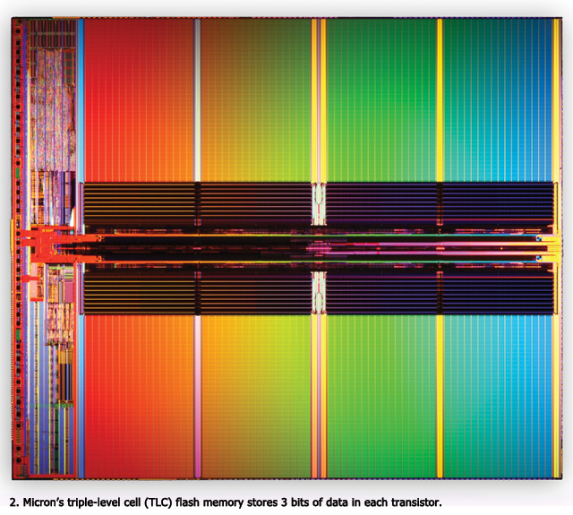
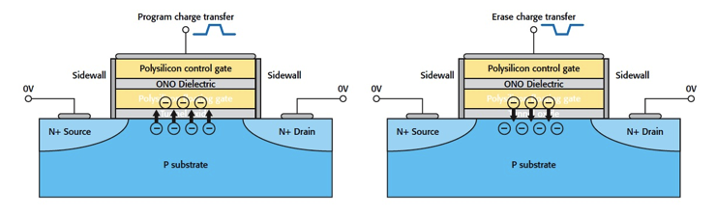
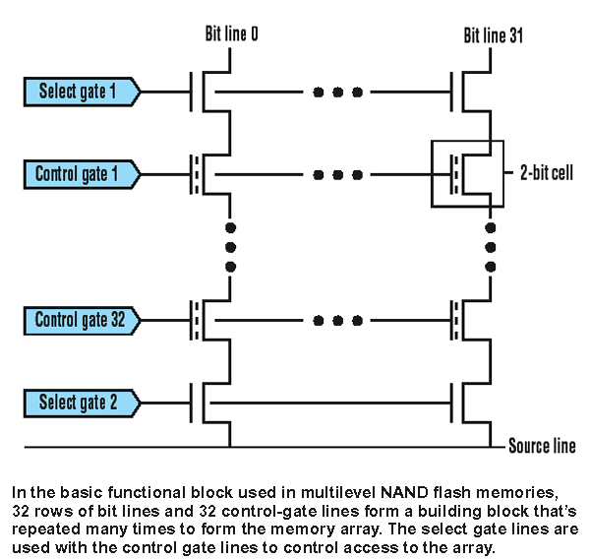
Solid state drives (SSDs) use flash memory
Still non-volatile
Significantly faster
0.1 ms to access (10 ms for disk)
More limited lifetime than disk
Limited writes
NMOS transistor with an additional conductor between gate and source/drain which “traps” electrons. The presence/absence is a 1 or 0

Slide 65
Failure rates for disks are a serious problem
Problem: disks fail
HDDs have physical actuators that wear out
SSDs have limited numbers of writes
Big problem: servers have many disks
Assume rate of failure per year of disk is 1%
And failures aren’t correlated
And a server has 264 disks
What are the odds that a disk will fail this year?
1 – (1 – 0.01)²⁶⁴ = 93% odds that at least one disk will fail

Slide 66
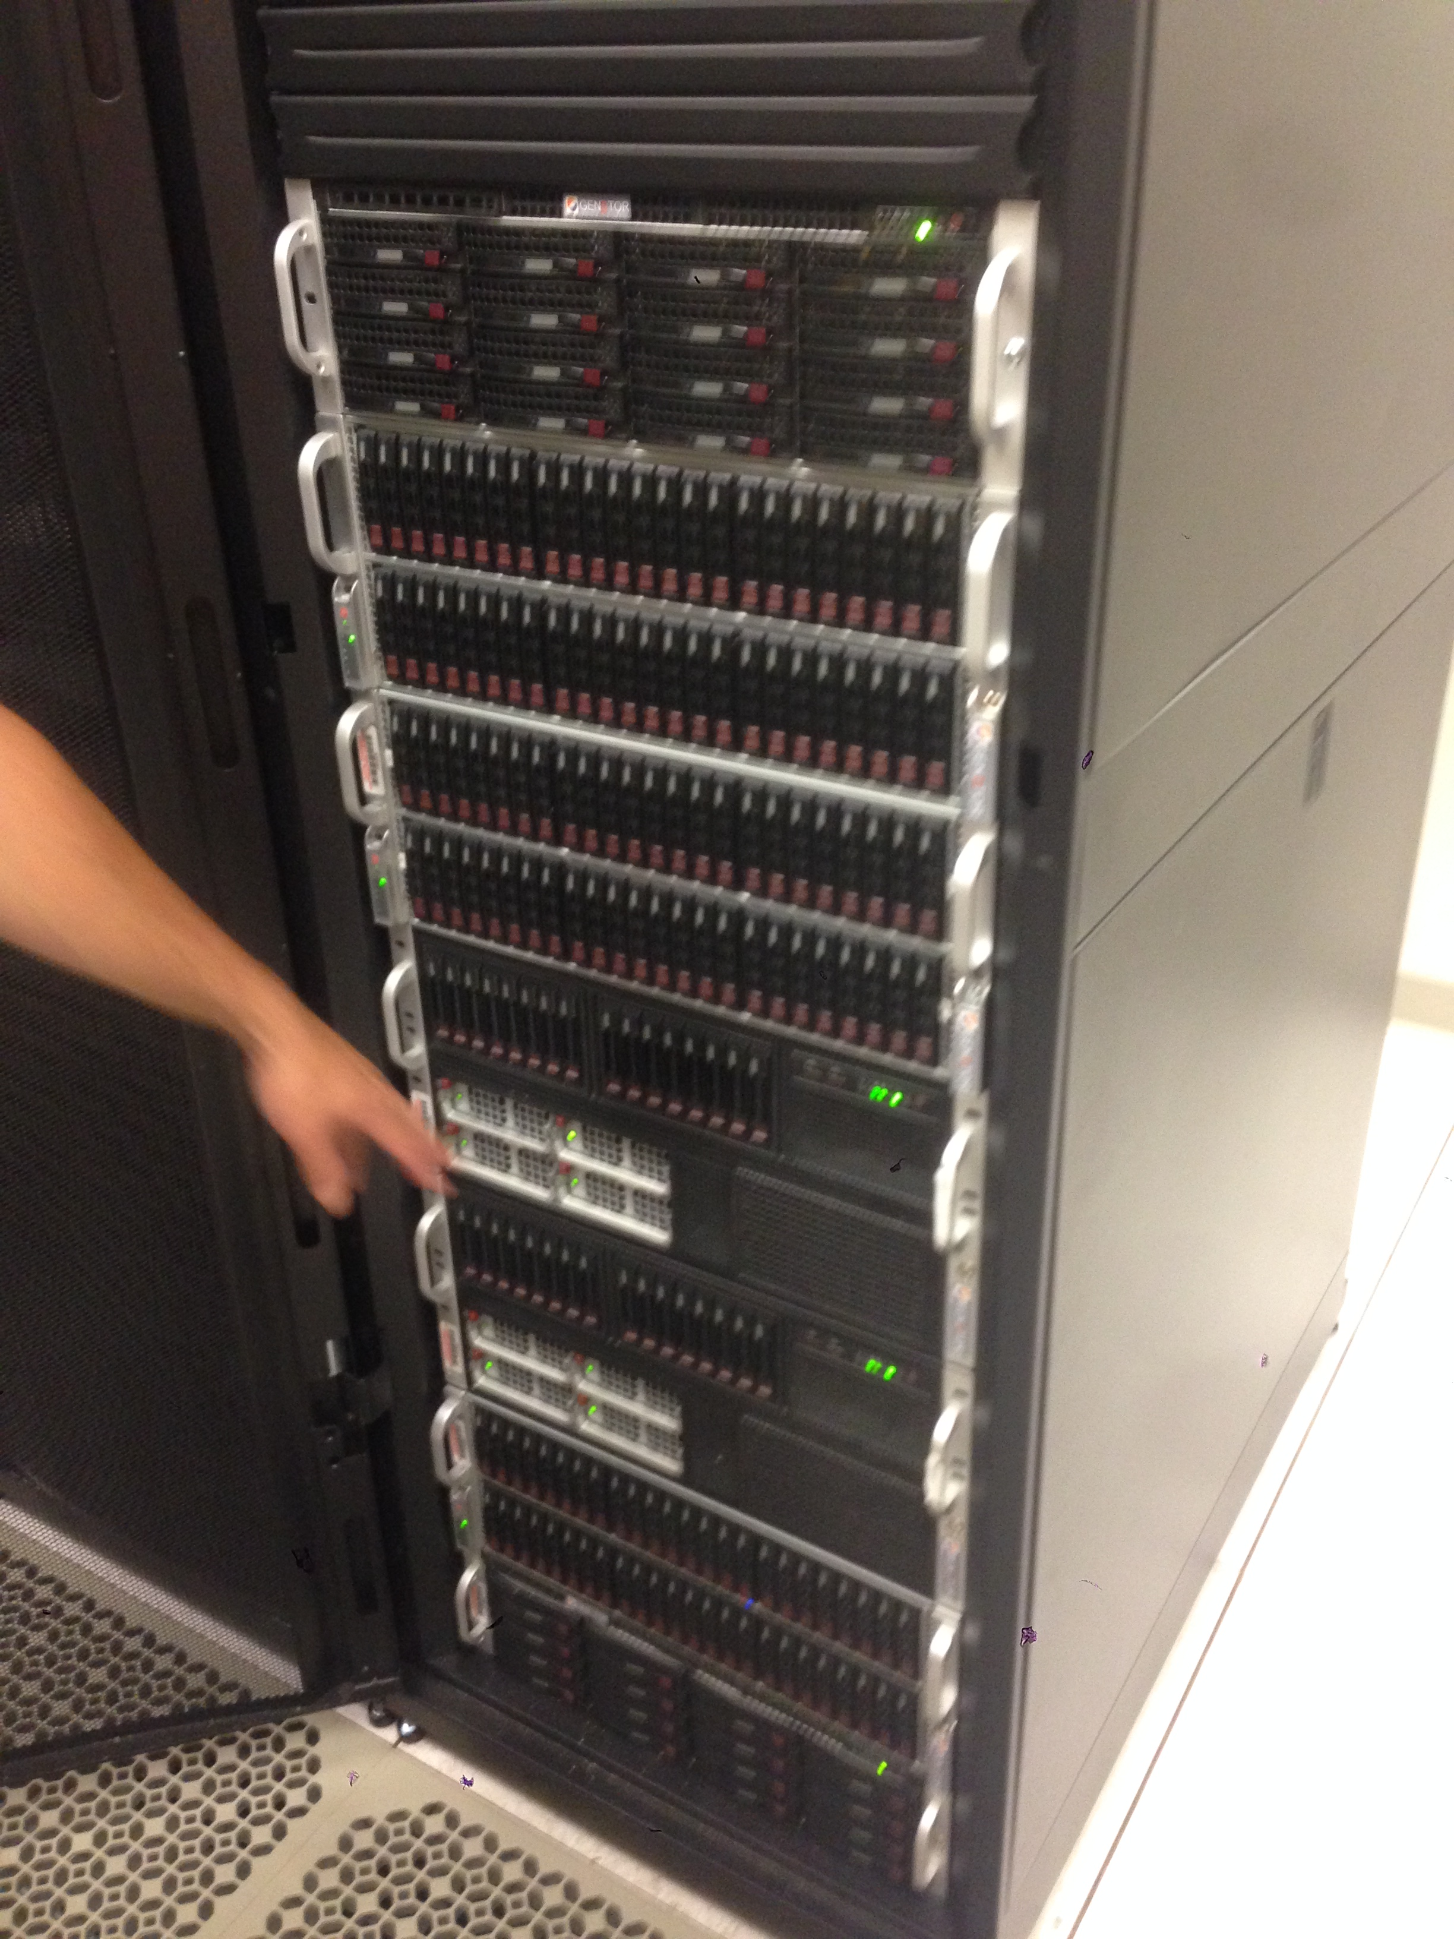
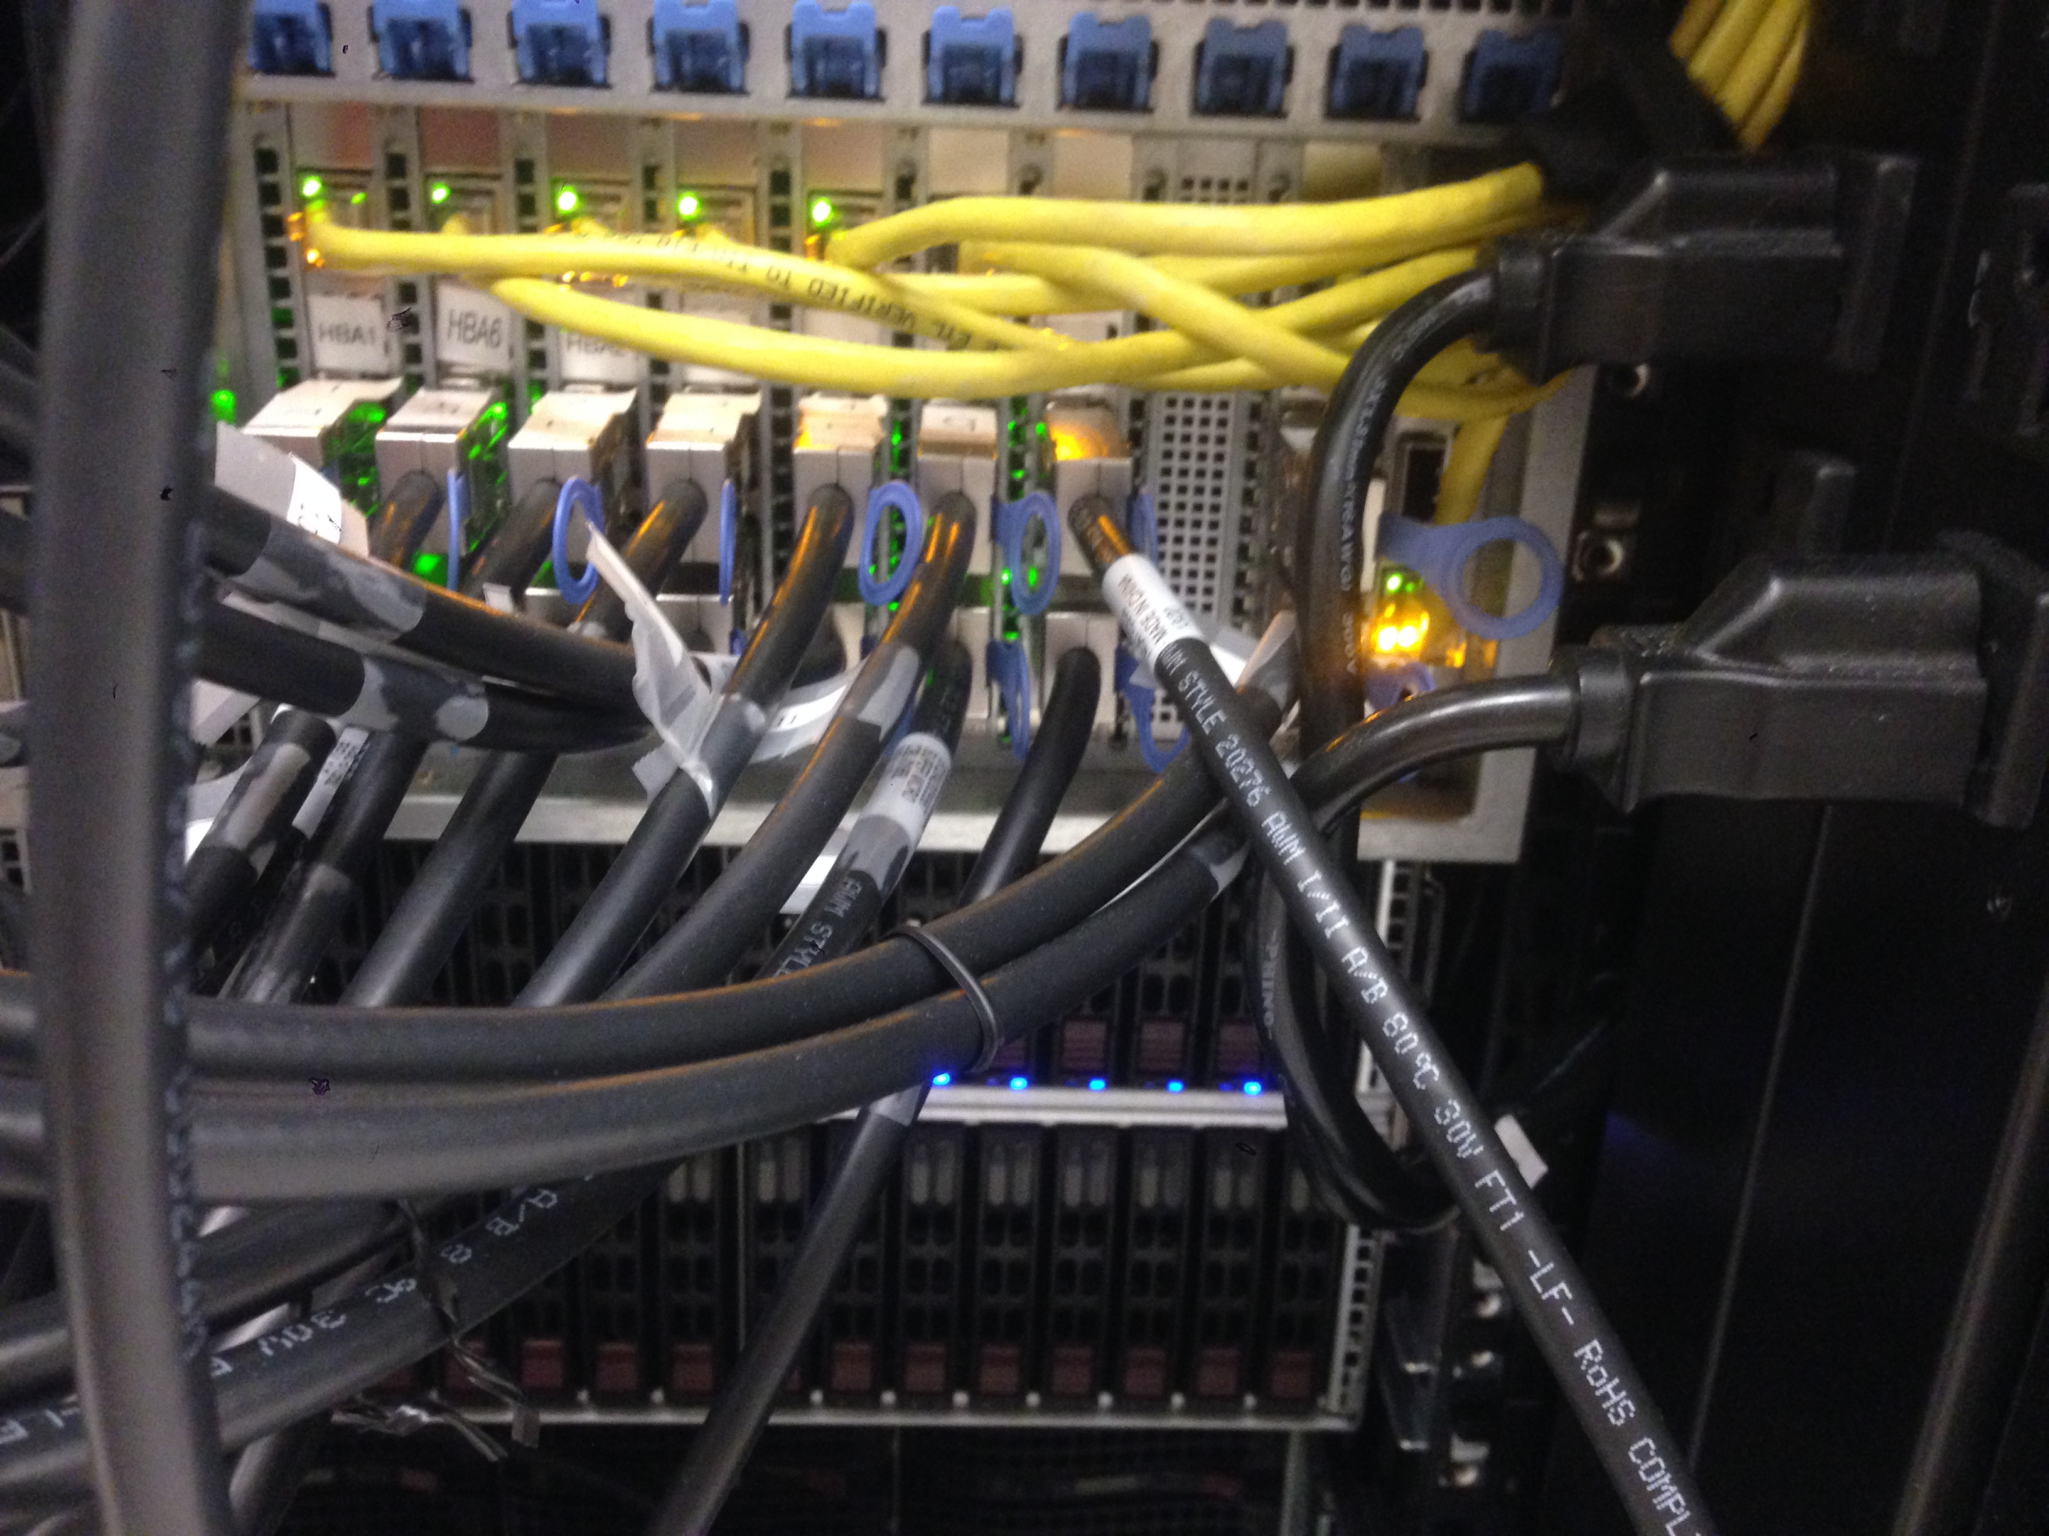
Database server at Northwestern
264 fast (10k RPM) magnetic disks (for production)
56 slow (7200 RPM) magnetic disks (for backup)
~150 TB storage capacity
Comprised of 6 physical chassis (boxes) in one big cabinet, about the size of a coat closet.

Slide 67
Redundant Array of Independent Disks (RAID)
Observation in 1988 (Patterson, Gibson, Katz)
Servers could use a high-quality mainframe disk drive
OR for the same cost
Servers could use several redundant low-quality consumer disk drives
Using an array of cheap disks actually improves multiple things
Reduce impact of a failure by storing data redundantly on multiple disks.
Increase capacity by making multiple disks available to store data.
Increase throughput by accessing data in parallel on multiple disks.

Slide 68
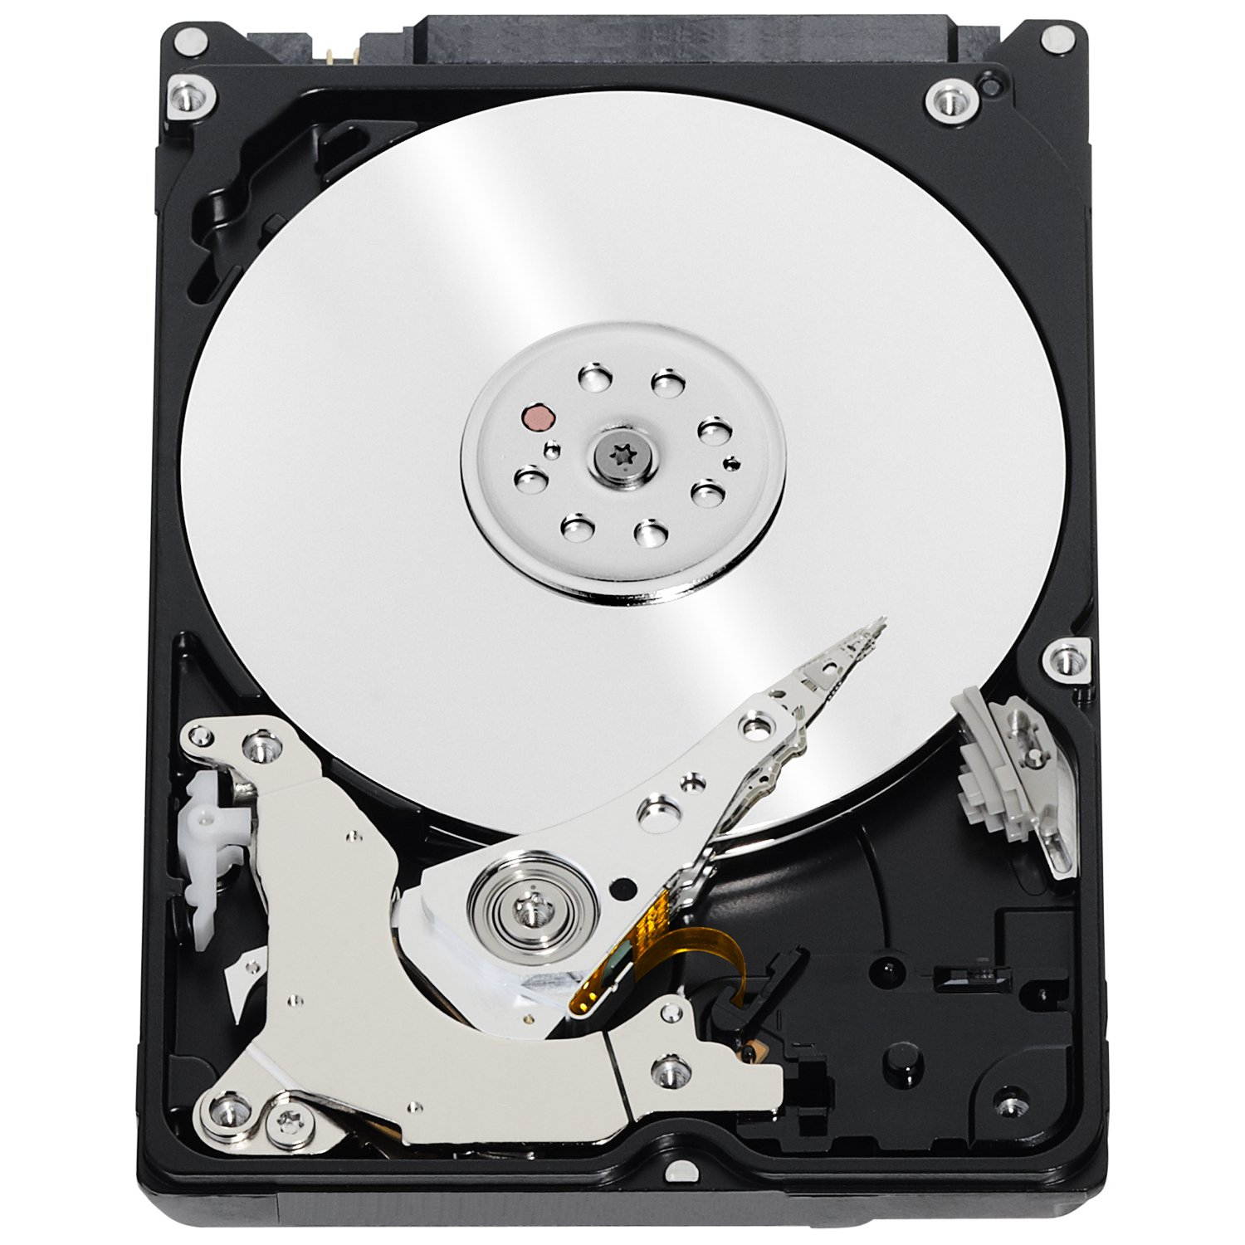

Basic idea of RAID
Combine many disks to create one superior virtual disk.
The RAID array provides the same interface as a single disk.
Computer thinks it’s dealing with this:
But it’s just an illusion. The reality is:
Sector r/w requests
Sector r/w requests
RAID virtual disk
RAID controller

Slide 69
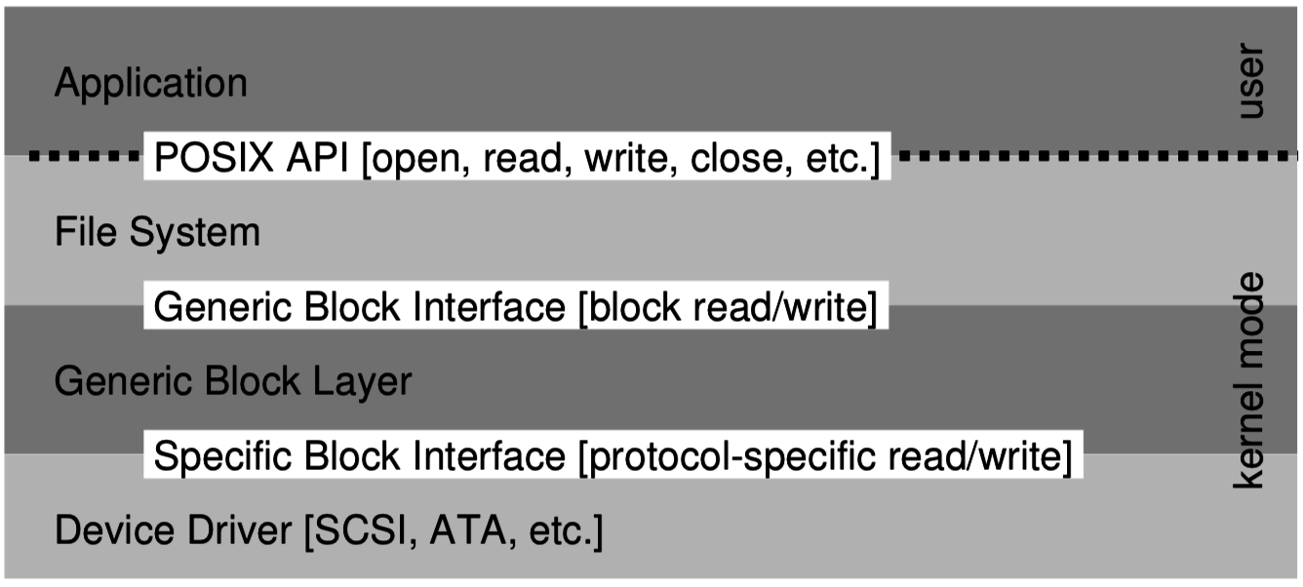
How does RAID fit into the OS?
RAID can be implemented in software or hardware
Software RAID means that the OS is responsible for assembling multiple disks into a RAID.
Implements a generic block device.
Hardware RAID requires a specialized controller card that coordinates the multiple disks, presenting interface of one disk.
OS just needs a driver for the RAID controller, like any other disk controller.

Slide 70
RAID levels
RAID 0 – Striping:
Distribute data across 2 disks for twice the peak throughput.
RAID 1 – Mirroring:
Copy data onto 2 disks to tolerate failure of one.
RAID 4/5/6 – Parity:
Keep parity bits around for each block to check for errors and rebuild.
Typically involves 3+ disks.

Slide 71
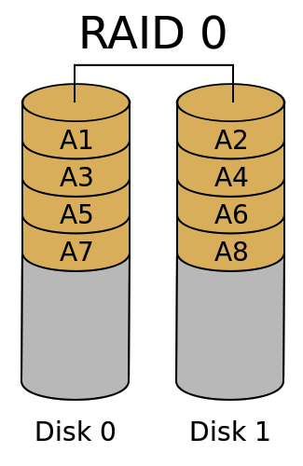
RAID 0 – Striping (for throughput and capacity)
Divide the logical disk into chunks
(A1, A2, A3 …) 1 or more blocks in size
Distribute the chunks regularly over two or more (N) physical disks.
(+) Throughput for both random and sequential access scales with N.
T_{RAID0} = N * T_{disk}
(+) Capacity also scales by N.
(+) Cost per byte is identical
(–) But Mean Time To Failure is worse because failure of a single disk is catastrophic:
MTTF_{RAID0} = MTTF_{disk}/N

Slide 72
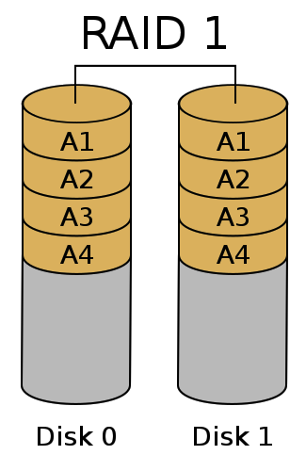
RAID 1 – Mirroring (for fault tolerance)
Duplicate each chunk on each of N physical disks.
(+) It is impossible to lose data unless all disks fail simultaneously.
i.e., failure window is reduced to the time it takes to replace a broken disk.
(–) Write throughput is not improved
(–) Capacity is the same as a single disk
(–) Cost per byte is greater
$_{RAID1} = N * $_{disk}

Slide 73
Check your understanding – RAID 1
(–) Write throughput is not improved
Is write throughput reduced in RAID 1? Or is it the same as a single disk?
What about read throughput?

Slide 74
Check your understanding – RAID 1
(–) Write throughput is not improved
Is write throughput reduced in RAID 1? Or is it the same as a single disk?
Same as a single disk
Write can go to both disks in parallel
What about read throughput?
Better than a single disk
Can read two different blocks at once!

Slide 75
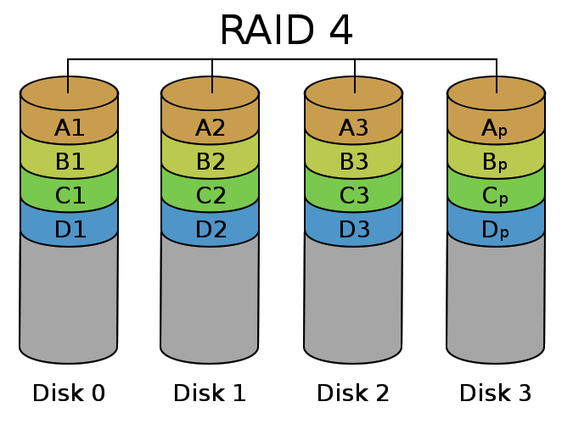
RAID 4 – Parity (for fault tolerance, capacity & throughput)
Distribute the chunks across the first (N-1) disks.
On the N^{th} disk, store a corresponding parity chunk.
Parity block is redundant data about a set of chunk (a stripe)
Can tolerate loss of any one disk
Parity disk becomes bottleneck for writes limiting throughput
Redundant data

Slide 76
How does parity work?
Even parity – add a 0 or 1 such that the total number of 1’s is even.
There also exists odd parity which makes the total number of 1’s odd
Examples (Even Parity):
0b0000_0000 – zero ones -> parity bit = 0
0b1111_1111 – eight ones -> parity bit = 0
0b0110_1101 – five ones -> parity bit = 1
If a single bit is lost, the parity bit allows us to infer the value of the lost bit

Slide 77
Check your understanding – Parity Recovery
What are the values of the missing bits?
Even Parity: make the total number of 1s even
[0, 0, 1, 0, ?, 0, 1, 1] – Even Parity with value: 1
[0, ?, 1, 1, 1, 0, 0, 0] – Even Parity with value: 0

Slide 78
Check your understanding – Parity Recovery
What are the values of the missing bits?
Even Parity: make the total number of 1s even
[0, 0, 1, 0, ?, 0, 1, 1] – Even Parity with value: 1
Value must be a 0
Because parity plus ones is already even
[0, ?, 1, 1, 1, 0, 0, 0] – Even Parity with value: 0
Value must be a 1
Because parity plus ones is not currently even

Slide 79
Parity can only fix a single error
What if two bits are missing?
[?, 0, 1, 0, ?, 0, 1, 1] – Even Parity: 1
Could both be zeros
Could both be ones
Impossible to tell which
More advanced “error correcting codes” are possible to detect/fix two or more errors
Hamming Code (single error correcting, double error detecting)

Slide 80
Parity chunk in RAID
Disk 0 | Disk 1 | Disk 2 | Disk 3 (parity)
0001 0010 1100 1100 | 0000 1111 0000 1111 | 1101 1111 0011 0001 | 1100 0010 1111 0010
1111 1111 1111 1111 | 0001 0001 0001 0001 | 1101 1001 0110 0110 | 0011 0111 1000 1000
0000 0000 0000 0000 | 1101 1011 0011 0011 | 1111 0011 0011 1000 | 0010 1000 0000 1011
Redundancy overhead
Useful storage capacity
Parity is computed bit-wise across corresponding chunks.
Chunks are one or more blocks (multiple of 4 kB) in size
Writing a small file will involve one disk plus the parity disk.
(parity disk can become a bottleneck)
Writing a large file will involve all the disks.

Slide 81
Rebuilding an array after failure
Disk 0 | Disk 1 | Disk 2 | Disk 3 (parity)
0001 0010 1100 1100 |  | 1101 1111 0011 0001 | 1100 0010 1111 0010
1111 1111 1111 1111 |  | 1101 1001 0110 0110 | 0011 0111 1000 1000
0000 0000 0000 0000 |  | 1111 0011 0011 1000 | 0010 1000 0000 1011
Disk failed!
If a disk fails, then we remove it and replace it with a working disk.
Then scan through the entire array to compute and write missing data.
This is called “rebuilding” the array
We cannot tolerate another disk failure until rebuild completes.
Reads/writes can continue while array is rebuilding!

Slide 82
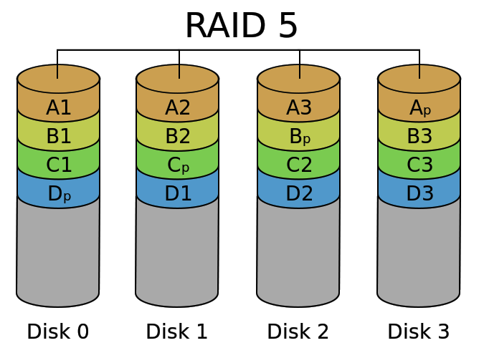
RAID 5 – Distributed Parity (the winner in practice)
Distribute parity chunks across the disks, to avoid a small-write bottleneck
(+) Failure of one disk is OK
(+) Throughput is good
T_{RAID5} = (N-1) * T_{disk}
(+) Cost per byte is good
$_{RAID1} = N/(N-1) * $_{disk}
(–) High overhead for small N
(–) Failure risk is high for large N
N is typically 3 to 8

Slide 83
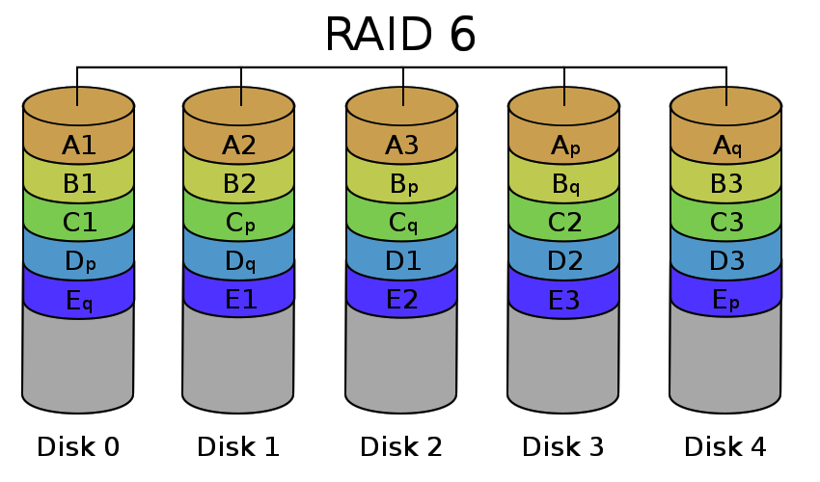
RAID 6 – Double Parity (for large arrays)
Add another disk and keep two parity chunks per stripe
2nd parity is computed differently
(+) Failure of two disks is OK
(~) Throughput is less:
T_{RAID5} = (N-2) * T_{disk}
(~) Cost per byte is higher:
$_{RAID1} = N/(N-2) * $_{disk}
Makes sense for larger N (>8)

Slide 84
Outline
Swapping
Overview
When To Swap
Page Replacement Policies
Implementing LRU
RAID

